Slide 1
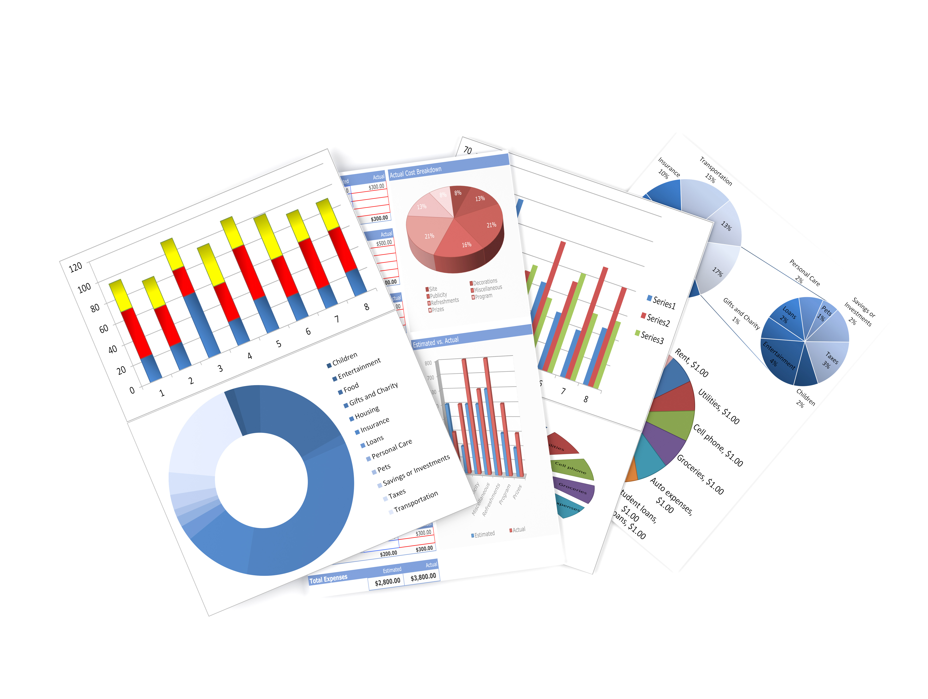

Financial Analysis
Understanding the numbers behind trends

Slide 2


Data visualization helps reveal patterns and supports data-driven strategies for success
To generate profound insights and comprehend the influence of business decisions on the company's profitability, we have developed an analysis that offers valuable information regarding trends, the impact of discounts, year-over-year growth, and product performance across clothing, bikes, accessories, and components. This analysis aims to identify growth opportunities and optimize business operations.

Slide 3




Data Analysis
Charts
Graphs
Insights
Our charts visualize the data trends effectively for better understanding.
The graphs display clear comparisons among different datasets for easy analysis.
Key insights highlight important findings derived from the data analysis process.

Slide 4


Year-on-Year Growth
This analysis shows the impact of strategic decisions on profitability over time
Profit in 2011
Profit in 2012
No data for comparison, due to LAG function
0.00%
-41.72%
Profit decreased significantly , despite high revenue , likely due to aggressive discounts.
Profit in 2014
Profit in 2013
Modest growth of 2.63%,though data is incomplete for the year
2.63%
Strong recovery with a 253.76% increase in profit . highlighting improved financial strategies
253.76%

Slide 5
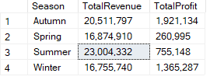
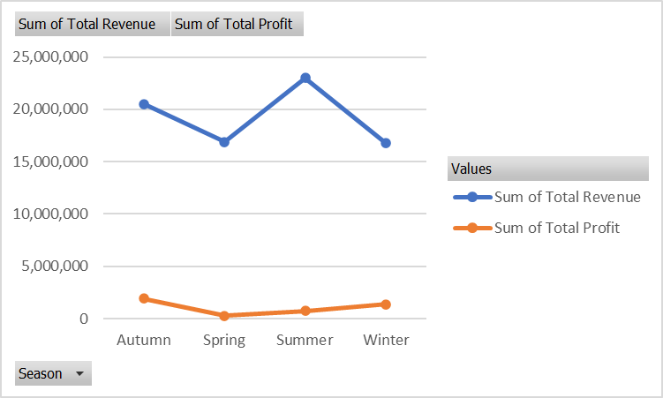
Seasonal Revenue and Profit Analysis
Revenue Trend
The total revenue fluctuates across the seasons, peaking in Summer at approximately 24,000.000.
The lowest revenue is observed in Winter, followed by Spring, where it drops just under 15,000.000
2. Profit Trend
Total Profit remains relatively consistent across the seasons, with minor fluctuations compared to revenue.
The profit line is significantly lower than the revenue, suggesting high operating costs or other expenses.
Since Revenue peaks in Summer and dips in Spring , consider a long-term strategy to balance these extremes. Diversify revenue or introduce new products/services that perform well in low-revenue seasons.

Slide 6
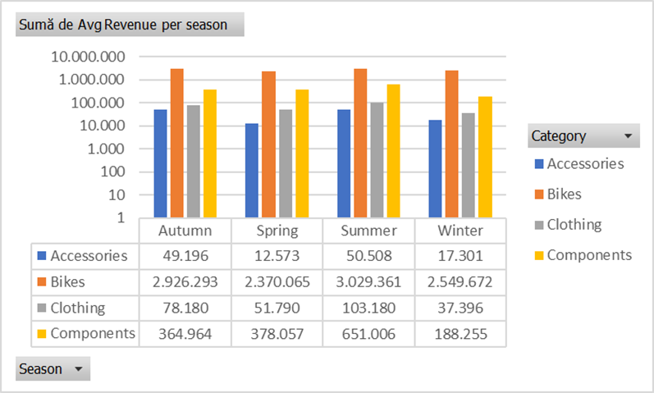
Seasonal Sales Performance Analysis
Bikes consistently generate the highest revenue across all season, peaking in Summer with over 3.029.361
The lowest bike sales are seen in Spring, indicating a potential opportunity for promotional efforts during this season.
Components show strong performance in Summer(651.006), aligning with peak bike sales. This suggests complementary purchasing behaviour.
Revenue from components drops significantly in Winter (188.255), likely due to reduced bike-related activity.
Boost Spring Revenue Target Bike sales with discounts or bundled promotions (bundle bikes with accessories, or components) to encourage higher sales.
Promote early-season biking campaigns to encourage demand.

Slide 7
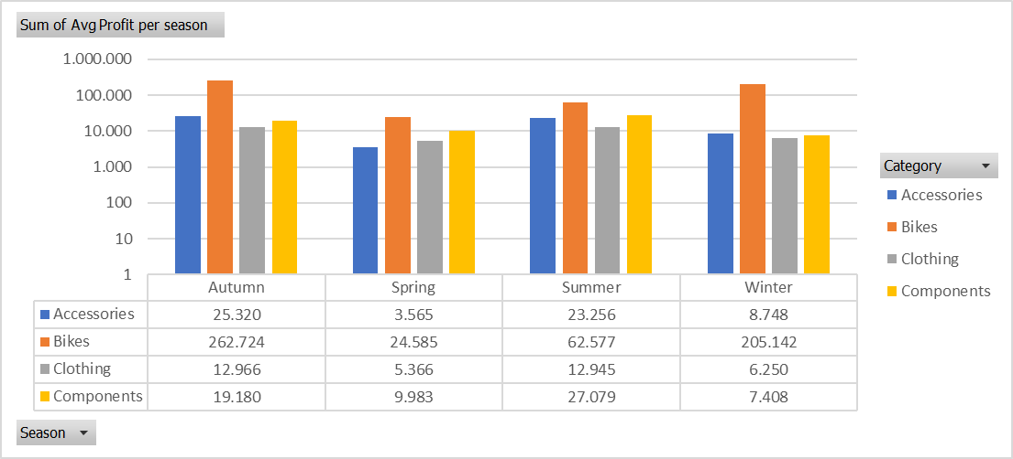
Profit Analysis Across Seasons
Bikes are the clear profit leader across all seasons, especially in Autumn(262.724) and Winter (205.142)
The lowest bike profit occurs in Spring (24.585) suggesting potential challenges during this season.
Accessories and clothing contribute little to overall profit, with their highest profits in Summer (Accessories:23.256, Clothing: 12.945)
Both categories see consistently low performance , with clothing profits particularly low in Winter (6.250)

Slide 8
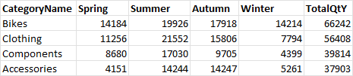
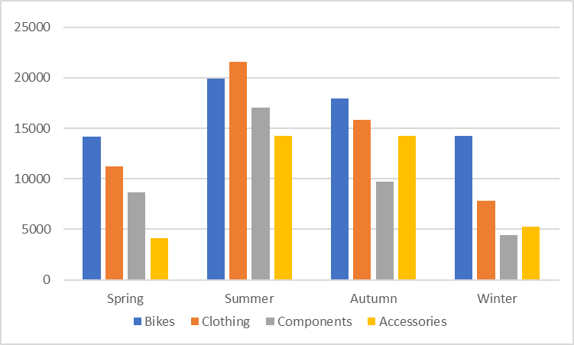
Seasonal sales analysis by calculating the total quantity of items
Overall, the highest sales occur in Summer , suggesting increased demand during this season, likely due to preparations for summer activities.
Winter is the weakest season for all categories, especially for Components.
Bikes’represent the category with the highest sales, far surpassing the other categories. The highest sales occur in summer (19.926), followed by autumn (17.918), having a lower demand in Spring and Winter.
Clothing is the second-best selling category, with a balanced distribution.

Slide 9
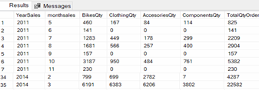
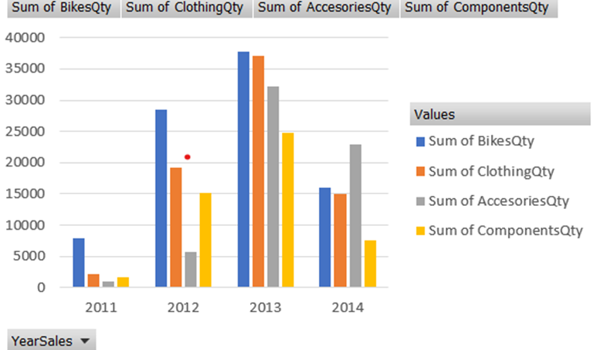
Yearly sales analysis by calculating the quantity of items
Year-over-year growth is evident in total orders and product category sales (e.g.May 2011- 825 total orders , May 2014 -15884 total orders.)
Irregular sales patterns: certain months in earlier years (e.g. 2011) show no product orders for specific categories , likely due to underdeveloped product lines or inconsistencies in sales strategies. In 2014, operational challenges such as inventory shortages or distribution delays may have contributed to these gaps. This could also explain the exceptionally high sales observed in March 2014, which recoreded 22,582 total orders.

Slide 10
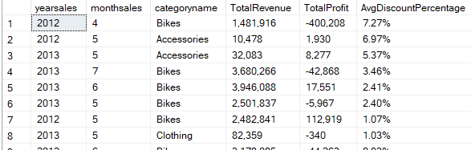
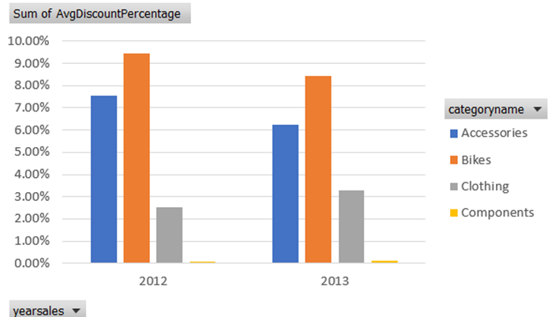
Discount Impact over Profit
Highlights categories with the highest average discounts in 2012 and 2013.
Allows comparison of TotalRevenue and TotalProfit for high-discount categories.
The large increase in discounts in 2012 might indicate that the company faced difficulties moving products, so they used discounts to increase sales and clear out inventory. This could have been necessary to meet sales goals or react to market conditions.
There is a correlation between aggressive discount and low profit.
Focus on profitability over Revenue
Shift the focus from pure revenue (e.g through excessive discounts) to sustainable profit growth by reducing discounts for underperforming products and focusing on high-margin categories.

Slide 11
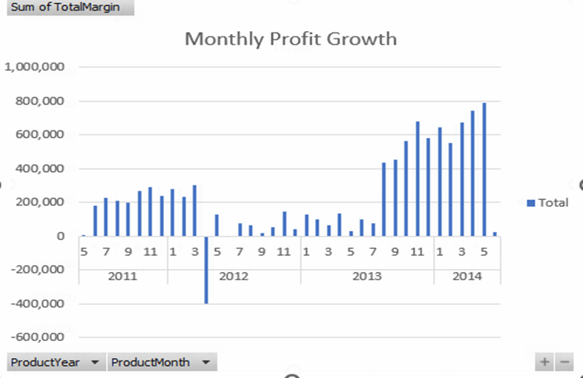
Analysis monthly profit during 2011 -2014
Overall Trend
• The graph demonstrates a clear upward trend in total monthly profit from 2011 to 2014.
• While 2011 and 2012 show relatively low or negative profit margins, there is significant improvement starting in 2013, which continues to grow steadily in 2014.
This analysis highlights a turnaround from inconsistent profitability in earlier years to strong growth in later years, indicating a company in the process of scaling and optimizing its business strategies.

Slide 12
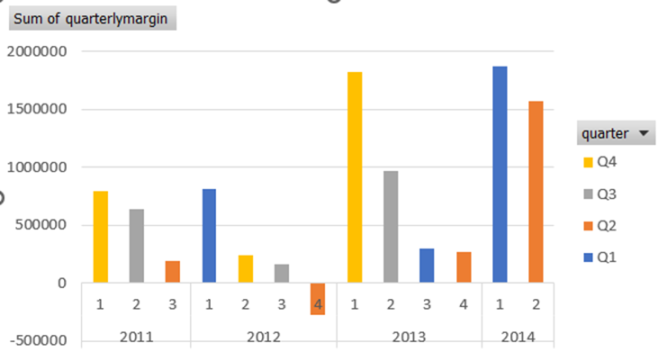
Analysis quarterly profit during 2011 -2014
Looking at the data overall, there is a clear seasonal pattern.
Q4 is often the strongest quarter, as seen in 2011, 2012, and 2013, likely due to higher sales during holidays or promotional periods.
Q1 also performs well in some years, such as 2012 and 2014, possibly because of leftover sales momentum from the holidays.
Q2 and Q3 are usually weaker quarters, showing slower sales during these periods.
This seasonal behavior can help guide sales strategies, focusing on maximizing resources during Q4 and improving performance in the middle quarters of the year.

Slide 13

Exploring insights through data
First idea: Pay attention on the discounts applied
Second idea: Inventory and marketing efforts
Third idea: Seasonal and Monthly Trends
Offering high discounts can be an effective strategy to attract customers and increase sales volume, but it can also lead to negative profit margins if not managed carefully.
Additionally, businesses should consider segmenting their market to apply targeted discounts that are aligned with customer purchasing behavior and profitability, thus safeguarding against eroding margins.
Ensure sufficient stock levels to meet increased demand, avoiding stockouts that could lead to lost sales opportunities.
Implement efficient inventory management systems to monitor stock levels in real-time, allowing for quick adjustments.
Recognizing and adapting to seasonality can ultimately lead to increased sales efficiency and improved customer satisfaction.
Focus on increasing visibility and engagement for best-selling products(bikes) by leveraging digital marketing channels such as social media, email campaigns, and targeted advertisements.

Slide 14

Thank you very much!
Paulo Perez
Raluca Ionita
Iulia Logofatu
Simona Hristescu
Presented by Red Team

